Slide 1

Computer Communications
& Networks
CSNC-2413
Week: 4
Computer Networking: A Top Down Approach
6th edition
Jim Kurose, Keith Ross
Addison-Wesley
March 2012
Application layer principles
Appl layer architectures
TCP Iterative Server
Dr Nauman Mazhar
Faculty of Information Technology (FIT)
University of Central Punjab (UCP)

Slide 2
Chapter 2: outline
2.1 Principles of network applications
2.2 Web and HTTP
2.3 FTP
2.4 Electronic mail
  SMTP, POP3
2.5 DNS
2.6 P2P applications
2.7 Socket programming with UDP and TCP

Slide 3
Some network apps
e-mail
web surfing
search engine
P2P file sharing
text messaging
social networking
remote login
streaming stored video
(YouTube, Netflix)
IP radio, TV
multi-user N/W games
voice over IP
(Skype, viber)
real-time video conferencing
…..
Appls require different types of services from the N/W…

Slide 4
Apps & Transport layer
All applications exist at the “Application layer”
Apps require different “types of services”
from Transport layer
  different Transport layers are available
  developer can choose the Transport layer that
  suits the appl needs
Once Transport layer is selected…
Appl operates by using only the services
provided by that protocol
application
transport
network
link
physical

Slide 5
Services required by Apps
Reliability
Service where data
is to be delivered
correctly & completely
(pkts may be lost due to bit errors, router buffer overflows)
Loss intolerant apps:
apps require reliable data transfer
(email, file transfer, web)
Loss tolerant apps:
apps can tolerate some loss (audio, video)
Thruput
Service where some min thruput may be required
(R bps)
B/W intensive apps:
apps require some min thruput to be “effective”
(IP telephony, video)
Elastic apps:
apps use whatever thruput is available
(web, email, file transfer)

Slide 6
Services required by Apps
Delay needs
Service where data may need delivery within some min delay
Real time Interactive apps:
have tight delay constraints
(IP telephony, teleconference,
Internet games)
Near-real time, &
Non-real time apps:
can tolerate delays
but lower delay is preferred
Security
Service where certain protection may be required
(using encryption)
Confidentiality: data not disclosed to un-authorized user
Data integrity: data not modified maliciously
Source authentication: data really comes from the source claimed

Slide 7
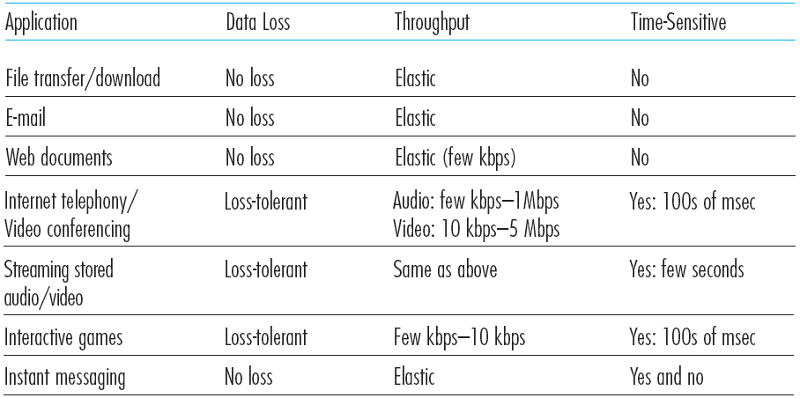
Transport services required: Common apps

Slide 8
Services provided by Transport layer
TCP service:
reliable transport: between sending & receiving process
connection-oriented: setup required between client & server
flow control: sender won’t overwhelm receiver
congestion control: sender won’t overload the network
does not provide: delay or thruput guarantee, security
UDP service:
unreliable data transfer: between sending & receiving process
does not provide: reliability, connection setup, flow control, congestion control, delay/thruput guarantee, or security
Q: why bother?
why is there a UDP?

Slide 9
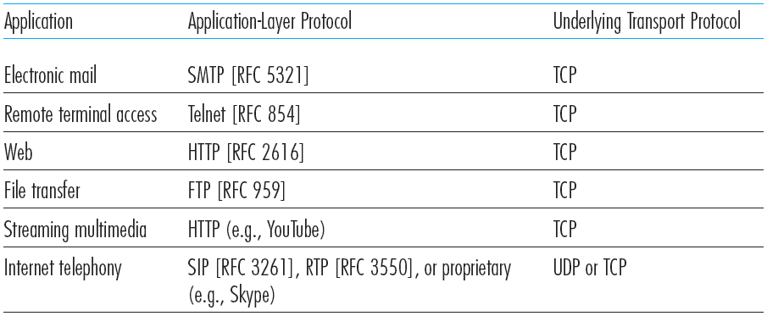
Common Internet apps & Transport protocols
Popular Internet applications, their Application-layer protocols, and their underlying Transport protocols

Slide 10
Apps & App-layer protocols
Difference between Apps & App-layer protocols
  App-layer protocol is a component of an application
Application layer protocols define…
  Types of messages exchanged:
  request, response
  Message Syntax:
  different fields in msgs; how fields are delineated
  Message Semantics:
  meaning of info in the fields
  Timings/Rules:
  when & how processes send/recv msgs, & respond to msgs

Slide 11
App-layer protocols
Open protocols:
defined in RFCs, allow for interoperability
e.g, HTTP [RFC 2616], FTP [RFC 959]
Proprietary protocols:
e.g, Skype, MS Exchange Server protocols

Slide 12
Internet Applications
Notes:
The long-distance carrier system provided in the United States and throughout the world was designed to transmit voice signals over high-capacity transmission links, such as optical fiber, coaxial cable, and microwave. Part of the evolution of these telecommunications networks to digital technology has been the adoption of synchronous TDM transmission structures. In the United States, AT&T developed a hierarchy of TDM structures of various capacities; this structure is used in Canada and Japan as well as the United States. A similar, but unfortunately not identical, hierarchy has been adopted internationally under the auspices of ITU-T.
The basis of the TDM hierarchy (in North America and Japan) is the DS-1 transmission format. The same DS-1 format is used to provide both multiplexed voice and digital data services. Above the DS-1 data rate of 1.544 Mbps, higher-level multiplexing is achieved by interleaving bits from DS-1 inputs. For example, the DS-2 transmission system combines four DS-1 inputs into a 6.312-Mbps stream. Data from the four sources are interleaved 12 bits at a time. Note that 1.544 × 4 = 6.176 Mbps. The remaining capacity is used for framing and control bits.

Slide 13
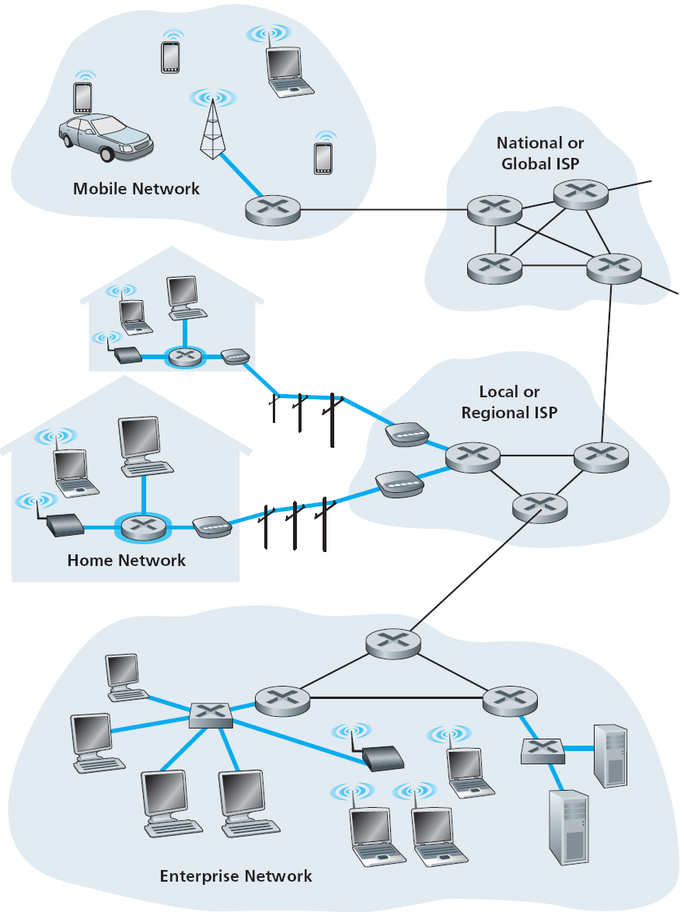
Creating network apps
application
transport
network
data link
physical
Appl programs are written only for end systems
appls exist only on hosts,
& comm over Internet
web browser comm with server
No need to write software for network-core devices…
network-core devices function at lower layers
confining appls to end systems
allows rapid appl development & deployment
application
transport
network
data link
physical
application
transport
network
data link
physical

Slide 14
Application architectures
Possible architectures for applications:
client-server
peer-to-peer (P2P)

Slide 15
Client-server architecture
client/server
Servers
always-on host
permanent addr (IP & port)
rely on fixed infra-structure
data centers for scaling
Clients
request services from servers
intermittent host connections
dynamic addr (IP & port)
no direct comm with each other

Slide 16
P2P architecture
peer-peer
NO always-on server
  arbitrary end systems comm directly
  peers request services from other peers, & also provide services
Min, or no reliance, on infra-structure
Self Scalability
  new peers bring new service demands
  also add new service capacity
Complex Management
  peers connect intermittently
  change IP addrs

Slide 17
Architectural Challenges
Client Server
Infra-structure intensive
Cost of server hardware, software & access network B/W
System management & maintenance needs/costs
May become a bottleneck
P2P
Not ISP friendly
  require high upload B/W, which might be a problem
Security issues
Incentives; users need to volunteer storage, bandwidth & computation resource

Slide 18
Socket Programming
TCP Client Server Communication
(TCP iterative server)

Slide 19
TCP Connection:
Setup/Teardown

Slide 20
TCP Connection Establishment
Client
Server
socket()
connect() blocked
(Active Open)
socket(),bind(),listen()
accept() blocks
(Passive Open)
SYN
SYN , Ack
connect() returns
Ack
accept() returns
read() blocked

Slide 21
TCP Connection Termination
Client
Server
close()
(Active Close)
FIN
(Passive Close)
read() returns 0
Ack
FIN
close()
Ack

Slide 22
TCP Connection
The pair IP Address + Port -– makes up a “socket-address”
A pair of “socket-addresses” defines a TCP connection
Client IP address
128.2.194.242
Server IP address
208.216.181.15
Connection socket pair
(128.2.194.242:3479, 208.216.181.15:80)
Client
Server
3479 is an
ephemeral port allocated by kernel (unix)
80 is a well-known
port associated with
Web servers
Client socket address
128.2.194.242:3479
Server socket address
208.216.181.15:80

Slide 23
TCP Client/Server Interaction
Server:
  create socket at server side
  bind with its Port number & IP address
  listen for connection requests
Client:
  create socket at client side
  send connection request
Server:
  accept connection request
Client/Server:
  send/receive user data
  close the connection

Slide 24
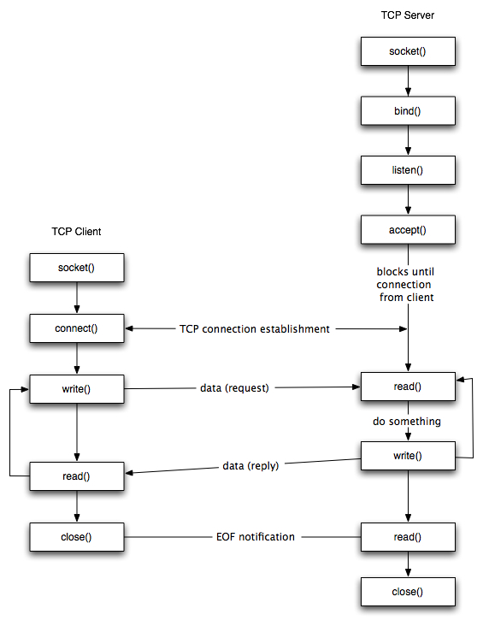
Connection Oriented Iterative Server
TCP Client Server

Slide 25
Example Code; Server

Slide 26
server.c
#include <stdio.h>
#include <stdlib.h>
#include <unistd.h>
#include <string.h>
#include <sys/socket.h>
#include <netinet/in.h>
#include <arpa/inet.h>
#define MYPORT 1233 /* my well-known port */
#define BACKLOG 10 /* length of pending connections queue */

Slide 27
server.c
int main(void)
{
int sockfd, new_fd; /* listen on sockfd */
/* new connection on new_fd */
struct sockaddr_in my_addr; /* server address */
struct sockaddr_in cli_addr; /* client addr */
int sin_size; /* address size */
sockfd = socket(AF_INET, SOCK_STREAM, 0);
my_addr.sin_family = AF_INET;
my_addr.sin_port = htons(MYPORT); /* convert to short, net byte order */
my_addr.sin_addr.s_addr = htonl(INADDR_ANY); /* auto fill with my IP */
bzero(&(my_addr.sin_zero), 8); /* zero the rest of the struct */

Slide 28
server.c
bind(sockfd, (struct sockaddr *)&my_addr, sizeof(struct sockaddr));
listen(sockfd, BACKLOG);
while(1) { /* main accept() loop ; always true*/
sin_size = sizeof(struct sockaddr_in);
new_fd = accept(sockfd, (struct sockaddr*) &cli_addr, &sin_size);
printf("server: connection from %s\n", inet_ntoa(cli_addr.sin_addr) );
send(new_fd, "Hello, world!\n", 14, 0);
close(new_fd);
} /* while loop ends here */
return 0;
} /* main function ends here */

Slide 29
Example Code; Client

Slide 30
client.c
#include <stdio.h>
#include <stdlib.h>
#include <errno.h>
#include <string.h>
#include <netdb.h>
#include <sys/types.h>
#include <netinet/in.h>
#include <sys/socket.h>
#define SERVPORT 1233 /* server well-known port */
#define SERVIP “127.0.0.1” /* server IP adress */
#define MAXDATASIZE 100 /* max number of bytes we can get at once */

Slide 31
client.c
int main (int argc, char* argv[])
{
int sockfd, numbytes;
char buf[MAXDATASIZE];
struct sockaddr_in serv_addr; /* server address information */
sockfd = socket(AF_INET, SOCK_STREAM, 0);
serv_addr.sin_family = AF_INET; /* interpreted by host */
serv_addr.sin_port = htons (SERVPORT);
serv_addr.sin_addr.s_addr =inet_addr(SERVIP);
bzero (&(serv_addr.sin_zero), 8); /* zero the rest of struct */
connect (sockfd, (struct sockaddr*)&serv_addr, sizeof (struct sockaddr));

Slide 32
client.c
numbytes = recv (sockfd, buf, MAXDATASIZE, 0);
buf[numbytes] = ‘\0’;
printf (“Received: %s”, buf);
close (sockfd);
return 0;
} /* main function ends */

Slide 33
Socket Programming Calls

Slide 34
Create Socket
int socket (int family, int type, int protocol);
create a socket
returns socket descriptor; -1 on error and sets errno
family : address family / protocol family
  AF_INET for IPv4, AF_INET6 for IPv6
type : type of communication
  SOCK_STREAM for TCP
  SOCK_DGRAM for UDP
  SOCK_RAW for Raw socket
protocol: protocol within family
  typically 0 (except for raw socket)

Slide 35
Bind the Socket
int bind (int sockfd, struct sockaddr* serverAddr, int addrlen);
bind a socket to a local IP address & port number
returns 0 on success; -1 on failure and sets errno
sockfd : socket descriptor (returned from socket)
serverAddr : includes IP address and port number
  IP address set by kernel if value passed is INADDR_ANY,
  else set by caller
  port number set by kernel if value passed is 0,
  else set by caller
addrlen : length of address structure
  sizeof (struct sockaddr_in)

Slide 36
Wait for Connections
int listen (int sockfd, int backlog);
server puts socket into listening state
(wait for connections rather than initiate a connection)
returns 0 on success; -1 on failure and sets errno
sockfd : socket descriptor
backlog : bound on length of un-accept()ed connection queue (connection backlog)

Slide 37
Send Connection Request
int connect (int sockfd, struct sockaddr* servaddr, int addrlen);
client connects to another (server) socket
returns 0 on success; -1 on failure and sets errno
sockfd : socket descriptor
servaddr : IP address and port number of server
addrlen : length of address structure

Slide 38
Accept Connection Request
int accept (int sockfd, struct sockaddr* cliaddr, int* addrlen);
Server accepts a new connection
(first one off the queue of pending connections)
Returns a new socket descriptor (connected socket) created by kernel;
-1 on error and sets errno
sockfd : socket descriptor (listening socket)
cliaddr : IP address and port number of client (when returned)
addrlen : length of address structure
  addrlen is a value-result argument
  caller passes size of client’s socket address structure
  kernel returns number of bytes stored in the address structure

Slide 39
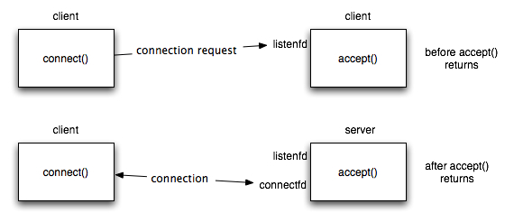
When accept() Returns
server

Slide 40
Send Data
int write (int sockfd, char* buf, size_t nbytes);
Write data to a stream socket (TCP)
Returns number of bytes written or -1; also sets errno on failure
sockfd : socket descriptor
buf : data buffer
nbytes : number of bytes to try to write
int send (int sockfd, char* buf, size_t nbytes, int flags);
flags : 0

Slide 41
Receive Data
int read (int sockfd, char* buf, size_t nbytes);
Read data from a stream socket (TCP)
Returns number of bytes read or -1; also sets errno on failure. Returns 0 if socket closed
sockfd : socket file descriptor
buf : data buffer
nbytes : number of bytes to try to read
int recv (int sockfd, char* buf, size_t nbytes , int flags);
flags : 0

Slide 42
Close Connection
int close (int sockfd);
Socket marked as closed, no more read/write calls
Returns 0 on success; -1 on failure and sets errno
sockfd : socket descriptor
TCP will try to send any data queued to be sent before close()
After close() sockfd not valid for reading or writing

